Slide 1
Research Methodology
Research on attack scenarios
Implementation and testing of ML model
Research on ML models
Research on normal scenarios
Evaluation of ML model
Creation of Testing Dataset
Creation of Training Datasets
Initial research on smart grids and cyber threats
Integration of best ML model in IDS

Slide 2
Training Datasets Breakdown
 | Constrained | NCombined | Unique Normal | Unique Normal Options Random
Config Violation: Trafo1 | 0 | 0 | 0 | 1294
Config Violation: Trafo2 | 0 | 0 | 0 | 1686
Config Violation: Trafo3 | 0 | 0 | 0 | 1671
Config Violation: Feeder1 | 0 | 239 | 5 | 128
Config Violation: Feeder2 | 0 | 208 | 567 | 1034
Config Violation: Feeder3 | 0 | 239 | 589 | 953
Lines over 80% | 7914 | 582 | 2016 | 2445
Load Lost > 20% | 0 | 1783 | 5442 | 1772
Transformers over 80% | 1428 | 275 | 5653 | 5624
More than 8 open switches | 3247 | 699 | 2176 | 407
bus PU violated | 0 | 0 | 140 | 170
No anomaly | 7411 | 15975 | 59953 | 28497
Total | 20000 | 20000 | 76541 | 45681

Slide 3
Testing Datasets Breakdown
 | Unconstrained | Attack | Special
Config Violation: Trafo1 | 5002 | 65536 | 0
Config Violation: Trafo2 | 586 | 16384 | 0
Config Violation: Trafo3 | 83 | 4096 | 0
Config Violation: Feeder1 | 10112 | 131072 | 0
Config Violation: Feeder2 | 3705 | 32768 | 0
Config Violation: Feeder3 | 446 | 8192 | 0
Lines over 80% | 6 | 0 | 8361
Load Lost > 20% | 0 | 0 | 0
Transformers over 80% | 0 | 0 | 6639
More than 8 open switches | 56 | 0 | 0
bus PU violated | 1 | 0 | 0
No anomaly | 3 | 4096 | 5000
Total | 20000 | 262144 | 20000

Slide 4
Powergrid Dataset Generation
Jia Wei

Slide 5
Types of Datasets
Unconstrained
Constrained
Normal without Disturbance
Normal with Disturbance
NCombined (Normal without Disturbance + Normal with Disturbance)
Special
Unique Normal (4096 Unique Normal Configurations x 5 load profiles x 5 toggling options)
Attack Dataset

Slide 6
Power Grid
GRID
Bus_0
Feeder0
Feeder1
Bus_1
GRID
s
S/S-1
Line L4
110kV
Bus_2
CB-0
Line L0
CB-4
Bus_3
110kV
CB-1
CB-2
CB-5
CB-6
CB-3
T0
T1
Line L5
Line L6
Substation 1:
Feeder Lines: L0, L4 (CB0, CB4)
Feeder Breakers: CB-3
Transformers: T0, T1
Transformer Breaker: CB-10
Lines: L0 – L16 (Less L3 and L10)
Substation 2:
Feeder Lines: L2, L5 (CB2-CB151, CB5-CB152)
Bus Coupler Breakers: CB-153
Transformers: T2, T3
Transformer Breaker: CB-158
Lines: L14 – L21
Substation 3:
Feeder Lines: L1, L6 (CB1-CB171, CB6-CB172)
Bus Coupler Breakers: CB-173
Transformers: T4, T5
Transformer Breaker: CB-178
Lines: L22 – L25
Line L1
Line L2
10kV
Bus_8
Bus_9
10kV
CB-7
CB-8
CB-9
CB-10
CB-11
CB-12
CB-13
Line L12
Line L7
Line L8
Line L9
Line L11
Line L13
load0
load1
load2
load3
load4
load5
S/S-2
Bus 10-15
S/S-3
CB-151
CB-152
CB-171
CB-172
110kV
Bus_5
CB-153
110kV
110kV
CB-173
110kV
Bus_6
Bus_4
Bus_7
T2
T3
T4
T5
CB-158
CB-178
10kV
Bus_16
Bus_17
10kV
10kV
Bus_18
Bus_19
10kV
CB-15
CB-17
CB-19
CB-21
CB-14
CB-16
CB-18
CB-20
CB-22
CB-23
CB-24
CB-25
L14
L15
L16
L17
L18
L19
L20
L21
L22
L23
L24
L25
load6
load8
load10
load12
load14
load15
load16
load17
load7
load9
load11
load13
Bus 28 - 31
Bus 20 -27

Slide 7
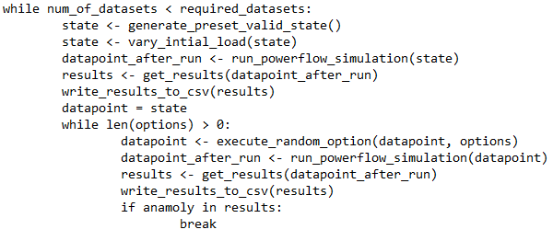
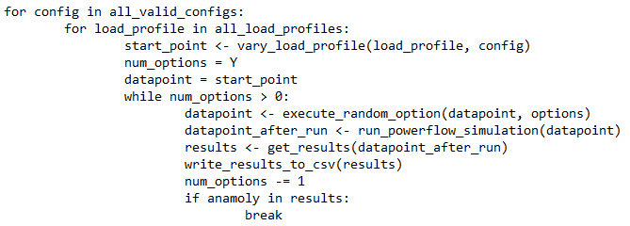
Summary of Training Dataset Generation
Step 1:
Set up Standard Grid layout
Use Pandapower to initialize grid layout
Initialize preset loads for lines 7-25
Create .csv and initialize headers for CBs/Loads/Trafos/Feeders
Constrained
NCombined
Unique_Normal
Constrained:
Randomize the loads in line 7-25 ranging from 70%-130% of the preset load
This non-anomalous datapoint can be of any valid configuration that ensures for each substation, at least 1 transformer and feeder is online and connected with load randomized.
Randomly switch on/off any load switches
Initialize Options and datasets factor
Initialize 4096 Unique Grid Configurations that are valid
2. Creating different datasets by starting at a non-anomalous datapoint
2a. This non-anomalous datapoint can be of any valid configuration that ensures for each substation, at least 1 transformer and feeder is online and connected with load randomized. (See constrained)
2b.Apply options on each previous datapoint in the dataset sequentially. If anomaly found in datapoint or no more options left, restart and generate a new dataset.
3. Stop when the number of datasets created hits the desired amount
Pseudocode:
2. Initialize Options + Set up different load profiles
3. Generate different datapoints for each of the 4096 unique config
3a. For each config, create X different starting points based on X load profiles
3b. For each starting point, generate Y different datapoints by applying Y options. Options are applied on the previous datapoint sequentially. If anomaly found in datapoint, stop applying options and continue to next starting point.
Pseudocode:

Slide 8
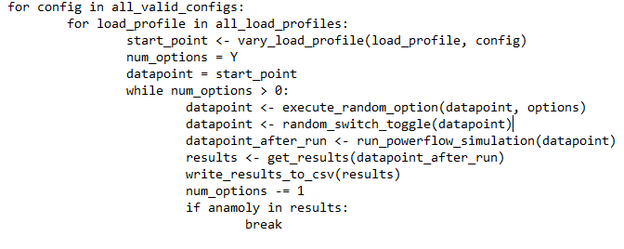
Summary of UNOR Dataset Generation
Step 1:
Set up Standard Grid layout
Use Pandapower to initialize grid layout
Initialize preset loads for lines 7-25
Create .csv and initialize headers for CBs/Loads/Trafos/Feeders
Unique Normal Options Random
Initialize 4096 Valid Unique Grid Configurations
2. Initialize Options + Set up different load profiles
3. Generate different datapoints for each of the 4096 unique config
3a. For each config, create X different starting points based on X different load profiles
3b. For each starting point, generate Y different datapoints by applying Y options, followed by randomly switching on or off ANY switches (34CBs + 6Trafos + 2 Feeders).
3d. Options are applied on the previous datapoint sequentially. If anomaly found in datapoint, stop applying options and continue to next starting point.
3c. In total, ideally we should have 4096 * X * Y datapoints (Y can vary if anomaly found)
Pseudocode:

Slide 9
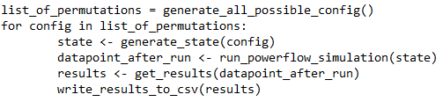
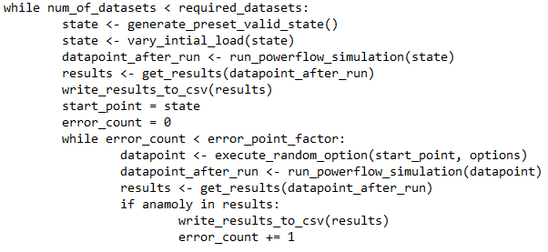
Summary of Testing Dataset Generation
Step 1:
Set up Standard Grid layout
Use Pandapower to initialize grid layout
Initialize preset loads for lines 7-25
Create .csv and initialize headers for CBs/Loads/Trafos/Feeders
Unconstrained
Attack
Special
Initialize Options and Error point factor and datasets factor
Unconstrained:
Randomize the loads in line 7-25 ranging from 70%-130% of the preset load
Randomly switch on/off any switches/transformers/feeders
Initialize all 8^6 Unique Grid Configurations
2. Creating different datasets by starting at a non-anomalous datapoint
2a. This non-anomalous datapoint can be of any valid configuration that ensures for each substation, at least 1 transformer and feeder is online and connected with load randomized. (See constrained)
2b. Set this datapoint as the starting datapoint
2c. Apply options on it till we get an anomalous datapoint.
2d. Repeat 2c for X number of times till we get X anomalous datapoint for 1 non-anomalous starting datappint.
3. Repeat 2,2a,2b,2c till the number of datasets created hits the desired amount.
Pseudocode:
2. Run powerflow simulation for each of the grid configuration and save results to csv file.
Pseudocode:

Slide 10
Load Profiles
Load 1 = 0-40%, Load 2=40-60%, Load 3=60-80%, Load 4=80-100%, Load 5=100-130%, Load 6=130-150%
load_profiles = [[0,40], [40,70], [70,100], [100,120], [120,150]]

Slide 11
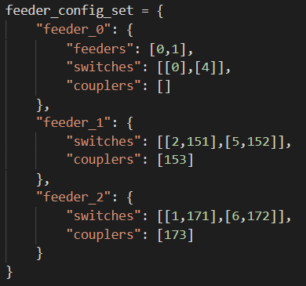
Options
Options: ['feeder_0', 'feeder_1', 'feeder_2', 'trafo_0', 'trafo_1', 'trafo_2', 'switch_7', 'switch_8', 'switch_9', 'switch_11', 'switch_12', 'switch_13', 'switch_14', 'switch_15', 'switch_16', 'switch_17', 'switch_18', 'switch_19', 'switch_20', 'switch_21', 'switch_22', 'switch_23', 'switch_24', 'switch_25’]
Feeder option:
Feeder_0: External to Substation 1, Feeder_1: SS1 to SS2, Feeder_3: SS1 to SS3
Turn off 1 random feeder (line), then enable corresponding coupler, For each turned off feeder (line), open at least 1 switch in the corresponding line

Slide 12
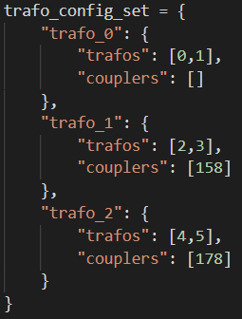
Options
Options: ['feeder_0', 'feeder_1', 'feeder_2', 'trafo_0', 'trafo_1', 'trafo_2', 'switch_7', 'switch_8', 'switch_9', 'switch_11', 'switch_12', 'switch_13', 'switch_14', 'switch_15', 'switch_16', 'switch_17', 'switch_18', 'switch_19', 'switch_20', 'switch_21', 'switch_22', 'switch_23', 'switch_24', 'switch_25’]
Transformer option:
trafo_0: Transformers in SS1, trafo_1: Transformers in SS2, trafo_2: Transformers in SS3
Turn off 1 random transformer and enable corresponding output coupler

Slide 13
Options
Options: ['feeder_0', 'feeder_1', 'feeder_2', 'trafo_0', 'trafo_1', 'trafo_2', 'switch_7', 'switch_8', 'switch_9', 'switch_11', 'switch_12', 'switch_13', 'switch_14', 'switch_15', 'switch_16', 'switch_17', 'switch_18', 'switch_19', 'switch_20', 'switch_21', 'switch_22', 'switch_23', 'switch_24', 'switch_25’]
Switch option:
Switch_7 to Switch_25: All switches connecting to lines with loads to external buses (L7-25)
For special dataset: close the switch to connect the line to the grid
For Unique_Normal/Ncombined dataset: open the switch to disconnect the line from the grid

Slide 14
Old Datasets

Slide 15
High Level Dataset Generation Steps
Common to all Datasets
Step 1: Initialization of Power Grid
Use Pandapower to create the grid template as shown in previous slide
Initialise switches (CB), loads, transformers and feeder index for .csv
Initialise loads to all lines connecting to external buses (L7-L25)
Load values preset for each lines in pandapower_net.py (Multiplied by load_mult_factor (2.8) to increase chance of anomalous datapoint incidence)

Slide 16
High Level Dataset Generation Steps
Specific to different Datasets
Step 2: Generation of datapoints
Generate datapoints till number of datapoints == Requested amount
For each datapoint, we first randomized the load values of the lines by multiplying the preset load values with a random percentage between 70 – 130% (Load Variance)
We then call vary_grid() function, that is specific to different datasets

Slide 17
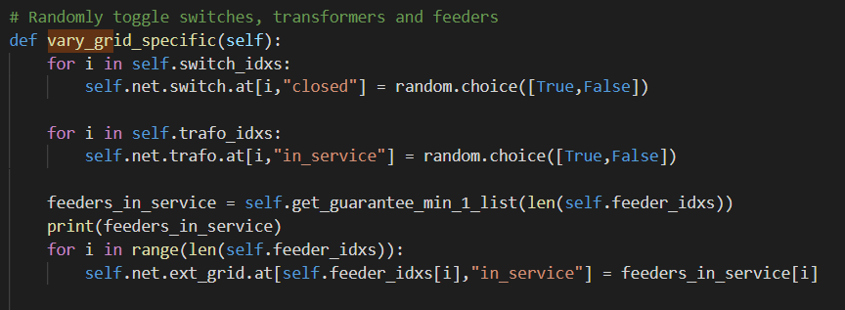
High Level Dataset Generation Steps
Unconstrained vary_grid()
Randomly close any feeder lines, switches, transformers with no context.
Do this for all datapoints and run the powerflow state stimulation for each datapoint to get results.
Step 3: Add datapoint result to .csv

Slide 18
High Level Dataset Generation Steps
Constrained/Normal with Disturbance vary_grid()
This dataset ensures that for each substation, at least 1 transformer/feeder is online and connected.
The feeder/transformer bus couplers will be activated if needed (except for CB-3 and CB-10 which are always closed) such that all loads are still connected in the grid unless their respective switches are open
E.g. Line 2 from substation 1 to substation 2 is open/disconnected, CB-153 will then close to ensure the loads at L14-17 are still connected.
All other non-constrained switches are closed/open randomly
Constrained Switches:
Feeder Switches: Substation 1: (0, 4), Substation 2: (2, 5, 151, 152), Substation 3: (1, 6, 171, 172)
Coupler Switches: Substation 1: (3, 10), Substation 2: (153, 158), Substation 3: (173, 178)
Non-constrained Switches: CB7-25
Step 3: For constrained dataset, we add datapoint result to .csv
For normal with disturbance, we do further processing before adding to the csv file. More info later.

Slide 19
Normal with/without Disturbance and Special Dataset
The generation of these data requires special processing by making a dataset instead of a datapoint for each iteration.
For each dataset, we first generate 1 datapoint.
Normal without Disturbance datapoint: All feeder lines, transformers and switches are closed, online and connected except for the bus coupler circuit breakers (CB-153, CB158, CB173, CB178).
Normal with Disturbance datapoint: A constrained datapoint is generated. (See previous slide)
Special Datapoint: All loads are disabled first, before randomly applying X number “options” to the grid (Default is 5). We then run the powerflow simulation and ensure that this config is non-anomalous. If it is anomalous, we restart and keep repeating till the config is non-anomalous.
See next slide on how options work. It is used for normal with/without disturbance and special dataset.

Slide 20
Options
Options: ['feeder_0', 'feeder_1', 'feeder_2', 'trafo_0', 'trafo_1', 'trafo_2', 'switch_7', 'switch_8', 'switch_9', 'switch_11', 'switch_12', 'switch_13', 'switch_14', 'switch_15', 'switch_16', 'switch_17', 'switch_18', 'switch_19', 'switch_20', 'switch_21', 'switch_22', 'switch_23', 'switch_24', 'switch_25’]
Feeder option:
Feeder_0: External to Substation 1, Feeder_1: SS1 to SS2, Feeder_3: SS1 to SS3
Turn off 1 random feeder (line), then enable corresponding coupler, For each turned off feeder (line), open at least 1 switch in the corresponding line

Slide 21
Options
Options: ['feeder_0', 'feeder_1', 'feeder_2', 'trafo_0', 'trafo_1', 'trafo_2', 'switch_7', 'switch_8', 'switch_9', 'switch_11', 'switch_12', 'switch_13', 'switch_14', 'switch_15', 'switch_16', 'switch_17', 'switch_18', 'switch_19', 'switch_20', 'switch_21', 'switch_22', 'switch_23', 'switch_24', 'switch_25’]
Transformer option:
trafo_0: Transformers in SS1, trafo_1: Transformers in SS2, trafo_2: Transformers in SS3
Turn off 1 random transformer and enable corresponding output coupler

Slide 22
Options
Options: ['feeder_0', 'feeder_1', 'feeder_2', 'trafo_0', 'trafo_1', 'trafo_2', 'switch_7', 'switch_8', 'switch_9', 'switch_11', 'switch_12', 'switch_13', 'switch_14', 'switch_15', 'switch_16', 'switch_17', 'switch_18', 'switch_19', 'switch_20', 'switch_21', 'switch_22', 'switch_23', 'switch_24', 'switch_25’]
Switch option:
Switch_7 to Switch_25: All switches connecting to lines with loads to external buses (L7-25)
For special dataset: close the switch to connect the line to the grid
For normal with/without disturbance dataset: open the switch to disconnect the line from the grid

Slide 23
Normal with/without Disturbance
After creation of the first datapoint, we then apply options till an anomalous result is generated OR we run out of options to play with.
For each time an option is applied, we create a new datapoint and run the powerflow simulation. We add this new datapoint to the dataset.
Hence, the dataset in the generation of Normal with/without Disturbance will firstly have 1 starting datapoint, following by multiple datapoints that is created by applying options one step at a time (Options are removed each time they are applied)
We stop till a datapoint is deemed to be an anomalous result or there are no options to apply left → This results in a dataset
Repeat the process to create X number of dataset

Slide 24
Special
After creation of the first datapoint, we then apply one option at a time and for each option applied, we run the powerflow simulation. If it is an anomalous result, we add it to the dataset. If not, we apply another option and run again, repeating the process till we get an anomalous result.
We then restore the state of the grid to its original first datapoint state and apply options again.
Repeat this process till we get X number of anomalous datapoint for each starting datapoint.
If we run out of options and the result generated is not an anomaly, we generate a new first datapoint and try again.
So for each normal datapoint generated, we need to generate X number of anomalous datapoints. This will become a dataset.
Repeat the process till we hit K number of datasets

Slide 25
NCombined
This dataset comprises of combining the Normal with Disturbance dataset and Normal without Disturbance Dataset

